Slide 1
Software Design and Architecture(SE:2002)
Domain Models
Course Instructor: Romasha Khurshid
Email Address: Romasha.Khurshid@nu.edu.pk
Reference Book: Applying UML and Patterns (An introduction to Object-Oriented Analysis and Design And Iterative Development)
BY Craig Larman
Third Edition

Slide 2
Draw a Domain Model of given scenario:
FAST maintains a record of all the students and offers courses. Well-defined syllabus
is maintained for all the courses with a predefined list of subjects that are offered in each semester. Students are allowed to enroll in five courses each semester. Instructors in the FAST are assigned courses to teach, three courses according to the area that is specialized in and their availability. The students are allowed to take an exam for all the regular subjects offered in a specific semester. FAST prepares transcripts of the students based on the grades of all the subjects in which students appeared for the exam. Any student having greater than four backlogs in a year is detained and cannot appear for regular subjects in the next one year. There is a group of Course Administrators in the FAST to manage the courses including course content, assign courses to instructors and define the course schedule.

Slide 3
Domain Models
Key object-oriented analysis step: Decompose domain into noteworthy concepts or objects
UML class diagrams used to draw domain models
  Conceptual perspective. Shows:
    Domain objects (conceptual classes)
    Associations between domain objects
    Attributes of conceptual classes
Domain model is NOT a model of software objects or our design
The following should NOT be in a domain model
  Software artifacts: Window, database, …
  Responsibilities or methods

Slide 4
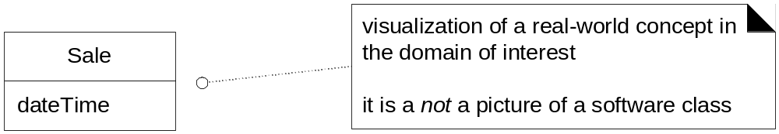
Fig. 9.3

Slide 5
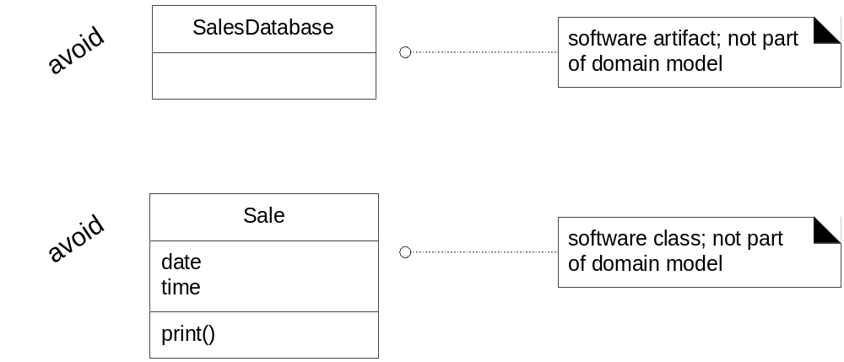
Fig. 9.4

Slide 6
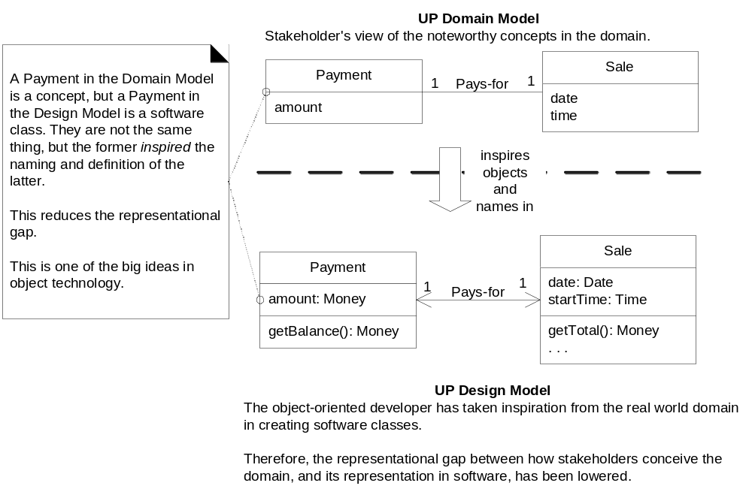
Software Class Names Inspired by Domain Model Objects

Slide 7
How to create a domain model?
Find conceptual classes
  How?
    Re-use or modify existing models
    Use a category list
    Identify noun phrases
    More on these later
Draw them as classes in a UML class diagram
Add associations and attributes
  More on this later

Slide 8
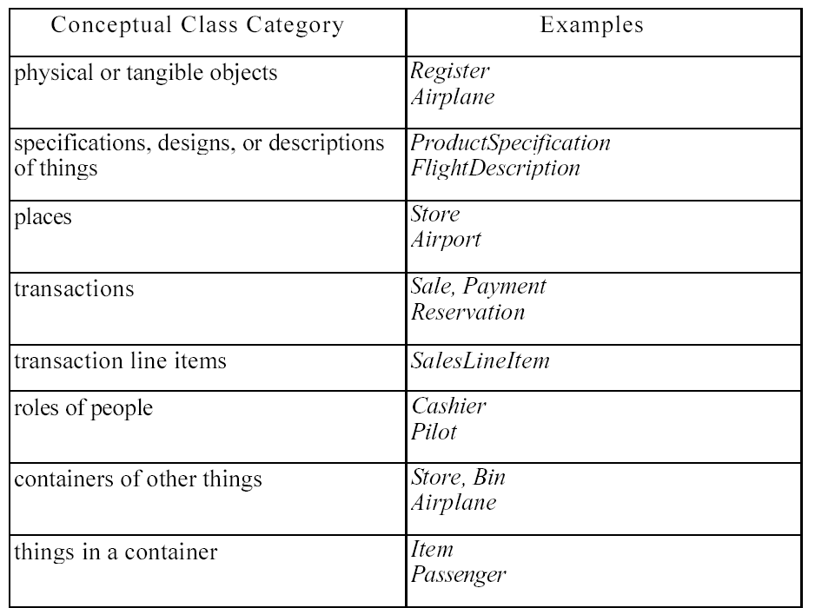

Slide 9
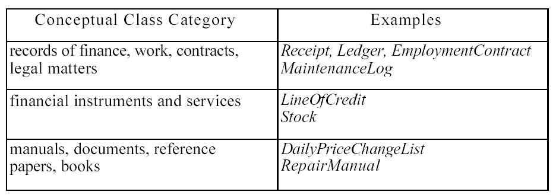

Slide 10
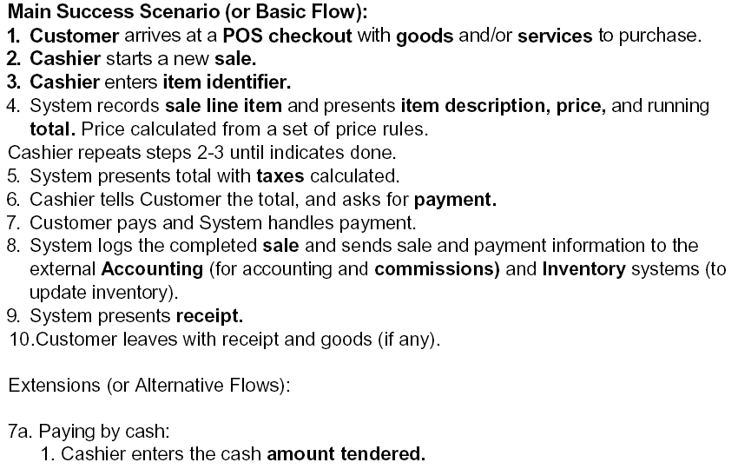

Identifying nouns as candidates for domain objects

Slide 11
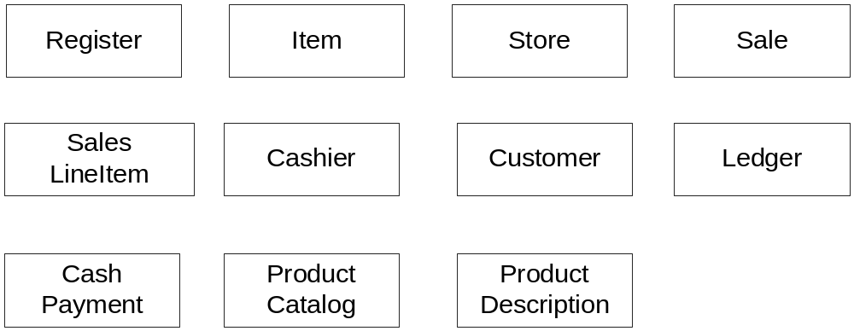
Candidate Conceptual Classes: Process Sale, Iteration 1

Slide 12
Attributes vs. Classes
Should “something” be
  an attribute of a class, or
  a separate conceptual class
Examples:
  Store: An attribute of Sale or separate class
    Store: Not a number or text
    Should be separate conceptual class
  Flight destination: An attribute or a separate class
    Destination is an airport, not a number
    Should be separate conceptual class
Guideline:
  If we thing of something as simply a number or text in real life, it should be an attribute.
  Otherwise it should be a conceptual class.

Slide 13
“Description” Classes
A description class contains information that describes something else
  Example: ProductDescription
  Records price, picture and text description of an item
Why use them? Why not include all that information in the Product class?
  We need this information stored and represented even though there are no objects of that particular product type.
  Don’t want to duplicate product information for each duplicate product object
    Serial number belongs with product object
    Picture of product belongs with product description
Need objects that are “specifications” or “descriptions” of other objects

Slide 14
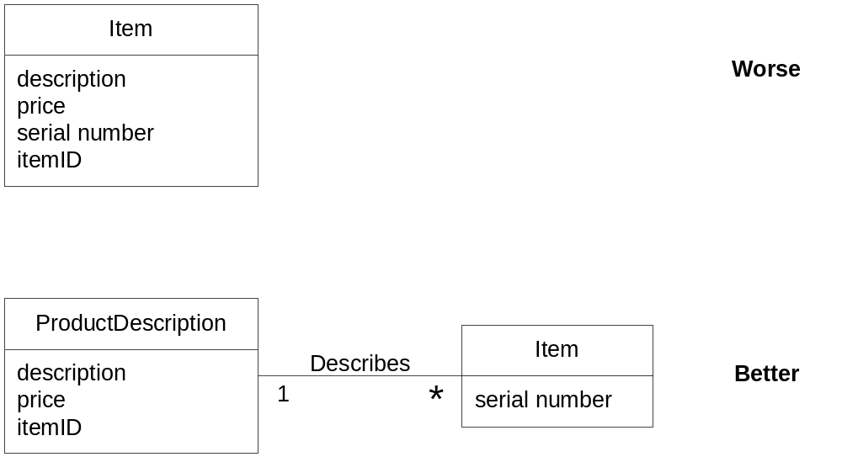
Description class example

Slide 15
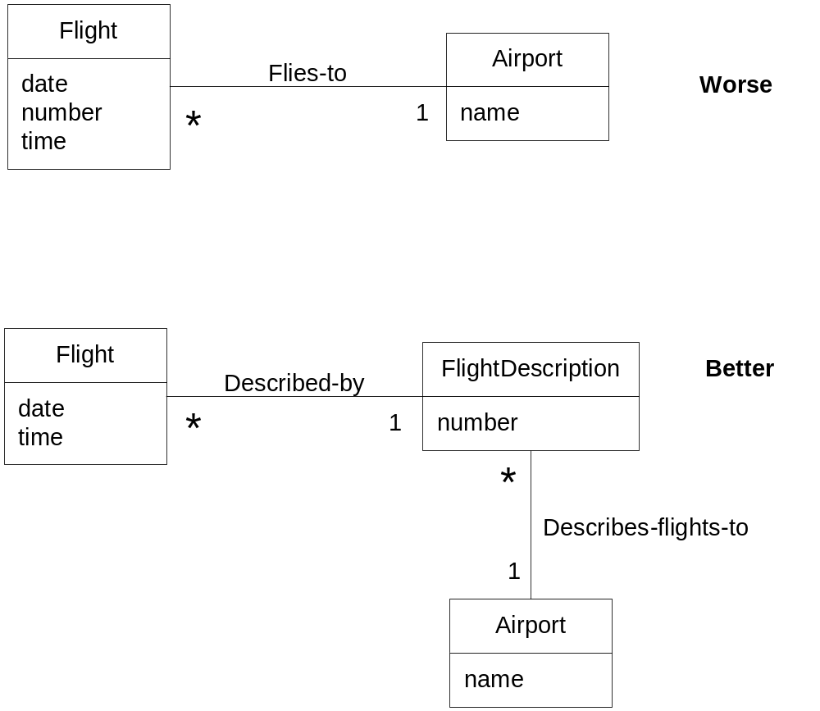
Description class example
Even when that flight is not
scheduled that day, the flight description exists.

Slide 16
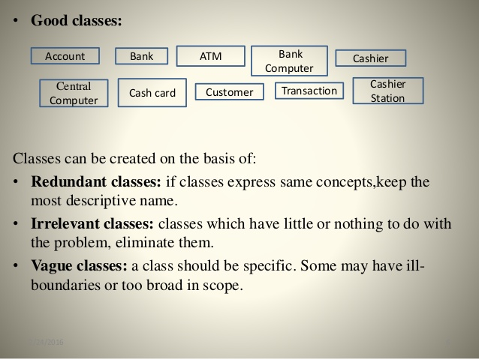
Something more on classes….

Slide 17
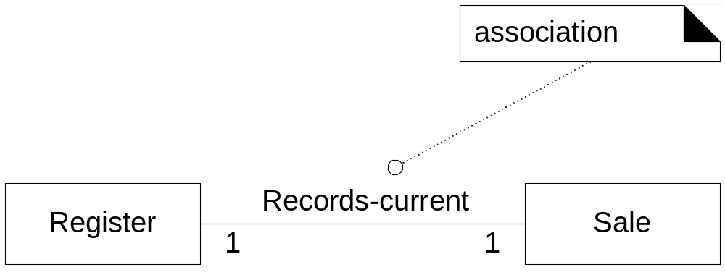
Associations
Association: A relationship between (instances of) classes that indicates some meaningful and interesting connection.
Used to show relationships that need to be remembered and preserved for some duration

Slide 18
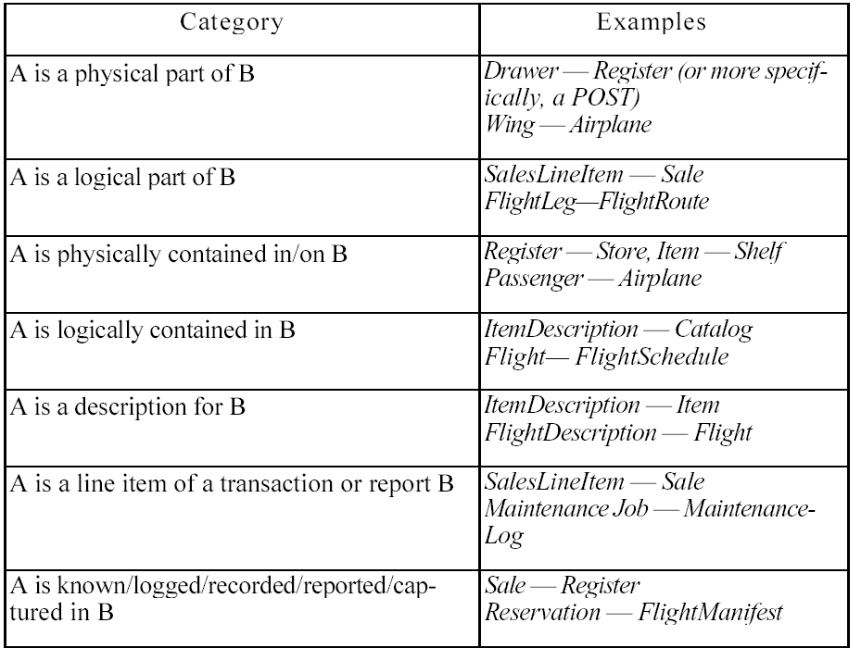
Common Associations List (i)

Slide 19
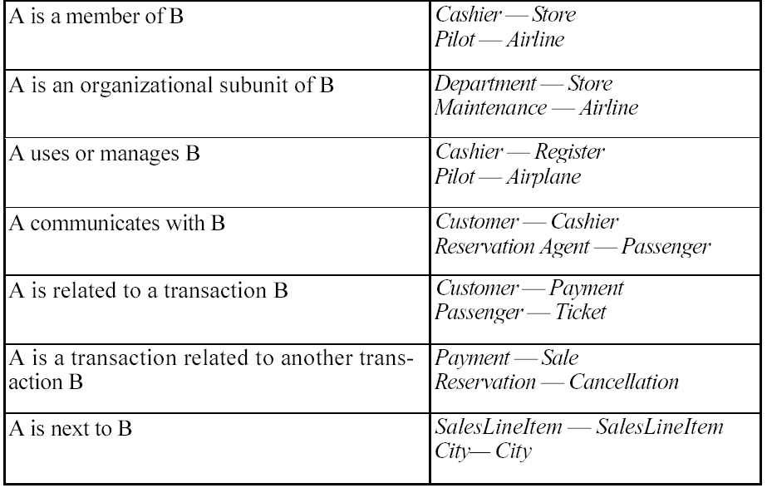
Common Associations List (ii)

Slide 20
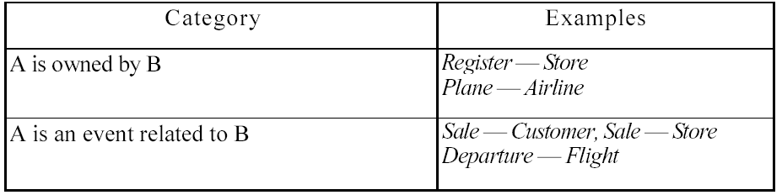
Common Associations List (iii)

Slide 21
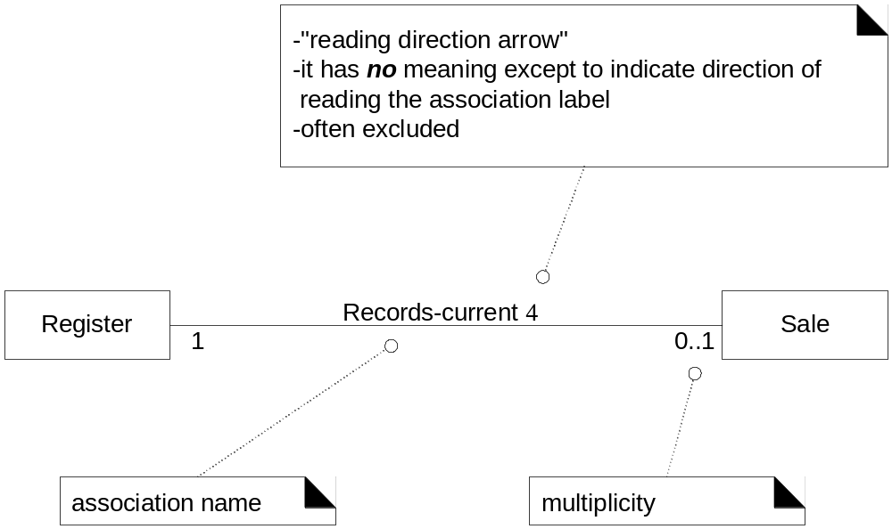
Association Directionalities

Slide 22
How to name an association?
Pattern:
  Class name – verb phrase – class name
  Readable and meaningful
Try to avoid “has” or “uses”. These give no extra information

Slide 23
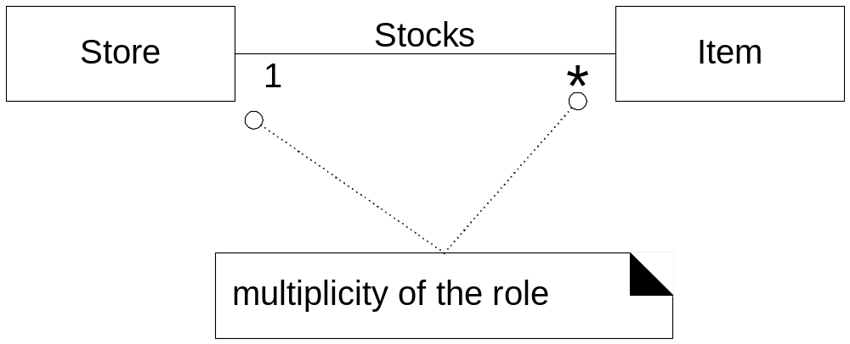
Association Multiplicities

Slide 24
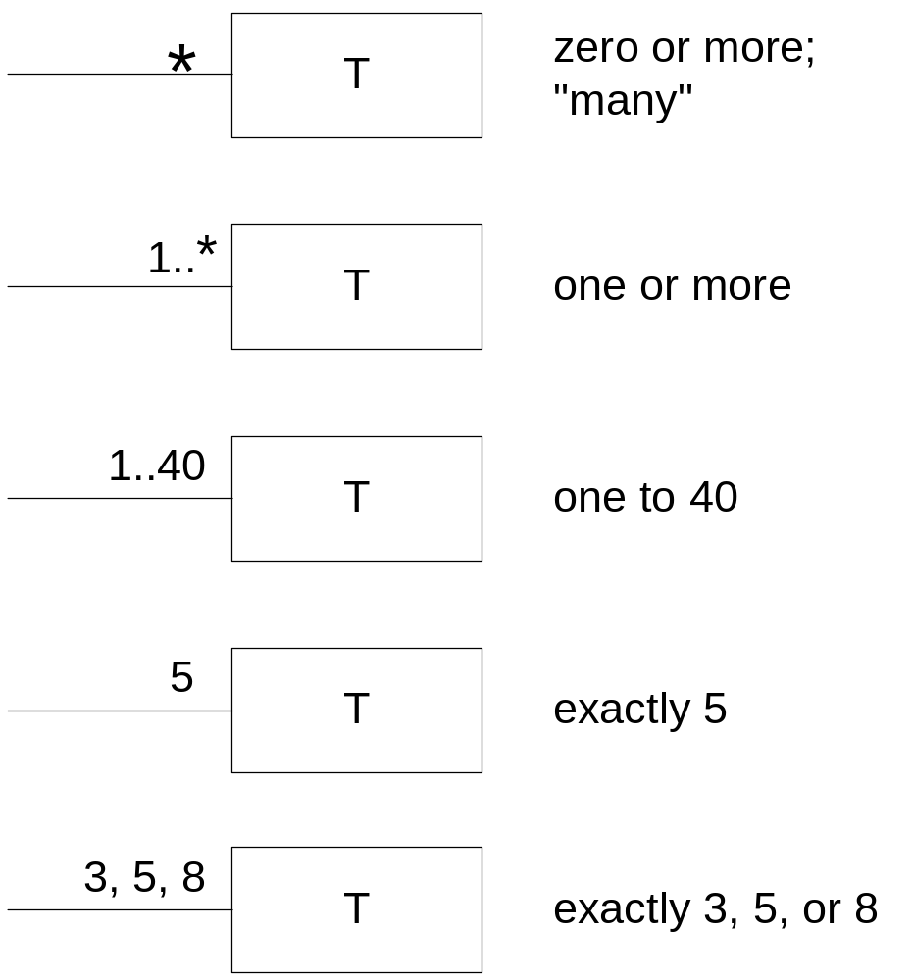
Multiplicities

Slide 25
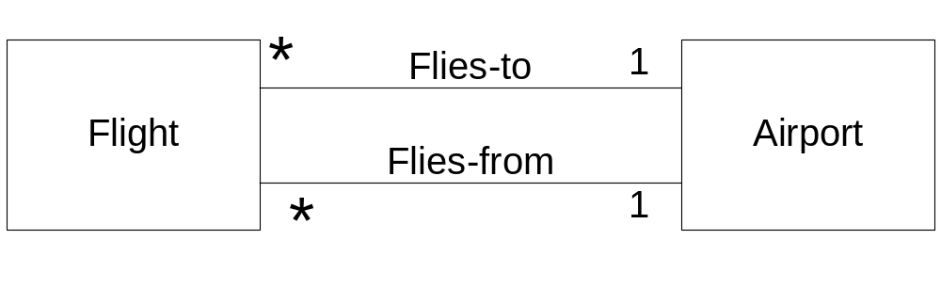
Multiple Associations

